Slide 1
CS 180 Problem Solving and Object Oriented Programming Fall 2011
http://www.cs.purdue.edu/homes/apm/courses/CS180Fall2011/
This Week:
10/24-28
Again: Multidimensional arrays
Methods
Menus
MenuListener
KeyListener
Quiz
Notes for Week 10:
Oct 24-28, 2011
Aditya Mathur
Department of Computer Science
Purdue University
West Lafayette, IN, USA

Slide 2
Readings and Exercises for Week 10
Readings:
Interfaces: 10.2, 10.3
Methods: 8.2, 8.3
GUI: 13.2, 13.3, 13.4
Exercises:
13.16, 13.17, 13.22

Slide 3
Announcements
No Feast with Faculty on Wednesday October 26, will resume next week.
No office hours on Wednesday Oct 26.
Wednesday lecture by Dr Gustavo Rodriguez-Rivera.
Homework 7 on the course site.
Extended offie hours on Friday 2-5pm.
This week’s lab will be an extended version of last week’s lab.
Try this for fun: tic-tac-toe data collection: http://oj.cs.purdue.edu:60080/sss/

Slide 4
Methods, method signatures, Interfaces and abstract classes

Slide 5
Method declaration
Syntax:
modifier type name (parameters){
body consisting of 0 or more statements.
};
Examples:
public String getModel (); // return string, no parameters
public boolean search(int []a, int n); // return boolean, two parameters
private void doIt(); // No return value, no parameter

Slide 6
Method call: Examples
Declaration: public String getModel (){ …. }
String s=getModel();// Return value assigned to s.
Declaration: public boolean search(int []a, int n){….}
boolean found=search(b, 15); // Return value assigned to found
Declaration: public void doIt();{ ….. }
doIt(); // No return value.

Slide 7
Method call: Parameter correspondence
Formal parameters
Declaration: public boolean search(int []a, int n){….}
boolean found=search(b, 15); // Return value assigned to found
Actual parameters:

Slide 8
Method call: Parameter passing
Formal parameters
Declaration: public boolean search(int []a, int n){….}
boolean found=search(b, 15); // Return value assigned to found
Actual parameters:
Reference to array b is passed to search; thus, inside search a reference to a is actually a reference to b.
15 is passed to search for n. Thus, inside search n is 15.

Slide 9
Method signatures: name and parameters: Yes
signature
void move (double dx, double dy);
distinct
signature
void move (int dx, int dy);
signature
void sort (int[] a);
distinct
signature
void sort (double[] a);

Slide 10
Method signatures: return type: Not included
boolean move (double dx, double dy);
Not distinct
int move (double dx, double dy);
Even though return types
are different

Slide 11
Classes, Interface, and Abstract Classes
Class
Constructor, methods; used to create objects
Interface:
Class with only method signatures , no code
An interface does not implement any method
Methods are implemented by a class that uses the interface
Thus, multiple implementations could exist

Slide 12
Interface: Example 1
Methods with signatures; not implemented
interface Car{
void cruise(double speed); // cruise at speed
void startEngine(); // Start car engine
void slowDown(double speed); // Slow down to speed
double getSpeed(); // Returns current speed
String getLicense(); // Returns license plate number
}

Slide 13
Interface: Example 2
interface ActionListener{
void actionPerformed(ActionEvent);
}
A user class implements an ActionListener and thus implements the actionPerformed() method.

Slide 14
Interface: Example 3
interface MouseListener{
void mouseClicked(MouseEvent e)
void mouseEntered(MouseEvent e)
void mouseExited(MouseEvent e)
void mousePressed(MouseEvent e)
void mouseReleased(MouseEvent e)
}
A user class implements a MouseListener. It should implement all of the above methods.

Slide 15
Interface: Example 1 : Implementation
public class MyCar implements Car{
public void cruise(double speed){ // cruise at speed
// Code to get car into cruise mode
}
public void startEngine(){ // Start car engine
// Code to start the engine
}
…… // Other methods
}
Methods implemented

Slide 16
Interface: When and why?
Use an interface to specify a contract between two parties.
When a team is developing an application, a core group of people can specify interfaces while other groups are free to implement these as they consider appropriate.
Example: A car manufacturer can specify an interface that will be used by software developers of all models made by this manufacturer.
Interfaces allow specification of uniform and contractual obligations across several products.

Slide 17
Abstract class
Similar to interface but may:
Implement zero or more methods
Provides abstract methods
An abstract method is one with only a signature but no implementation
A Java class can extend an abstract class by implementing one or more of its abstract methods.

Slide 18
Abstract class: Example
Empty implementations that may be overridden
public abstract class MouseAdapter{
void mouseClicked(MouseEvent e){}
void mouseEntered(MouseEvent e){}
void mouseExited(MouseEvent e){}
void mousePressed(MouseEvent e) {}
void mouseReleased(MouseEvent e) {}
}
A user class extends a MouseAdapter.

Slide 19
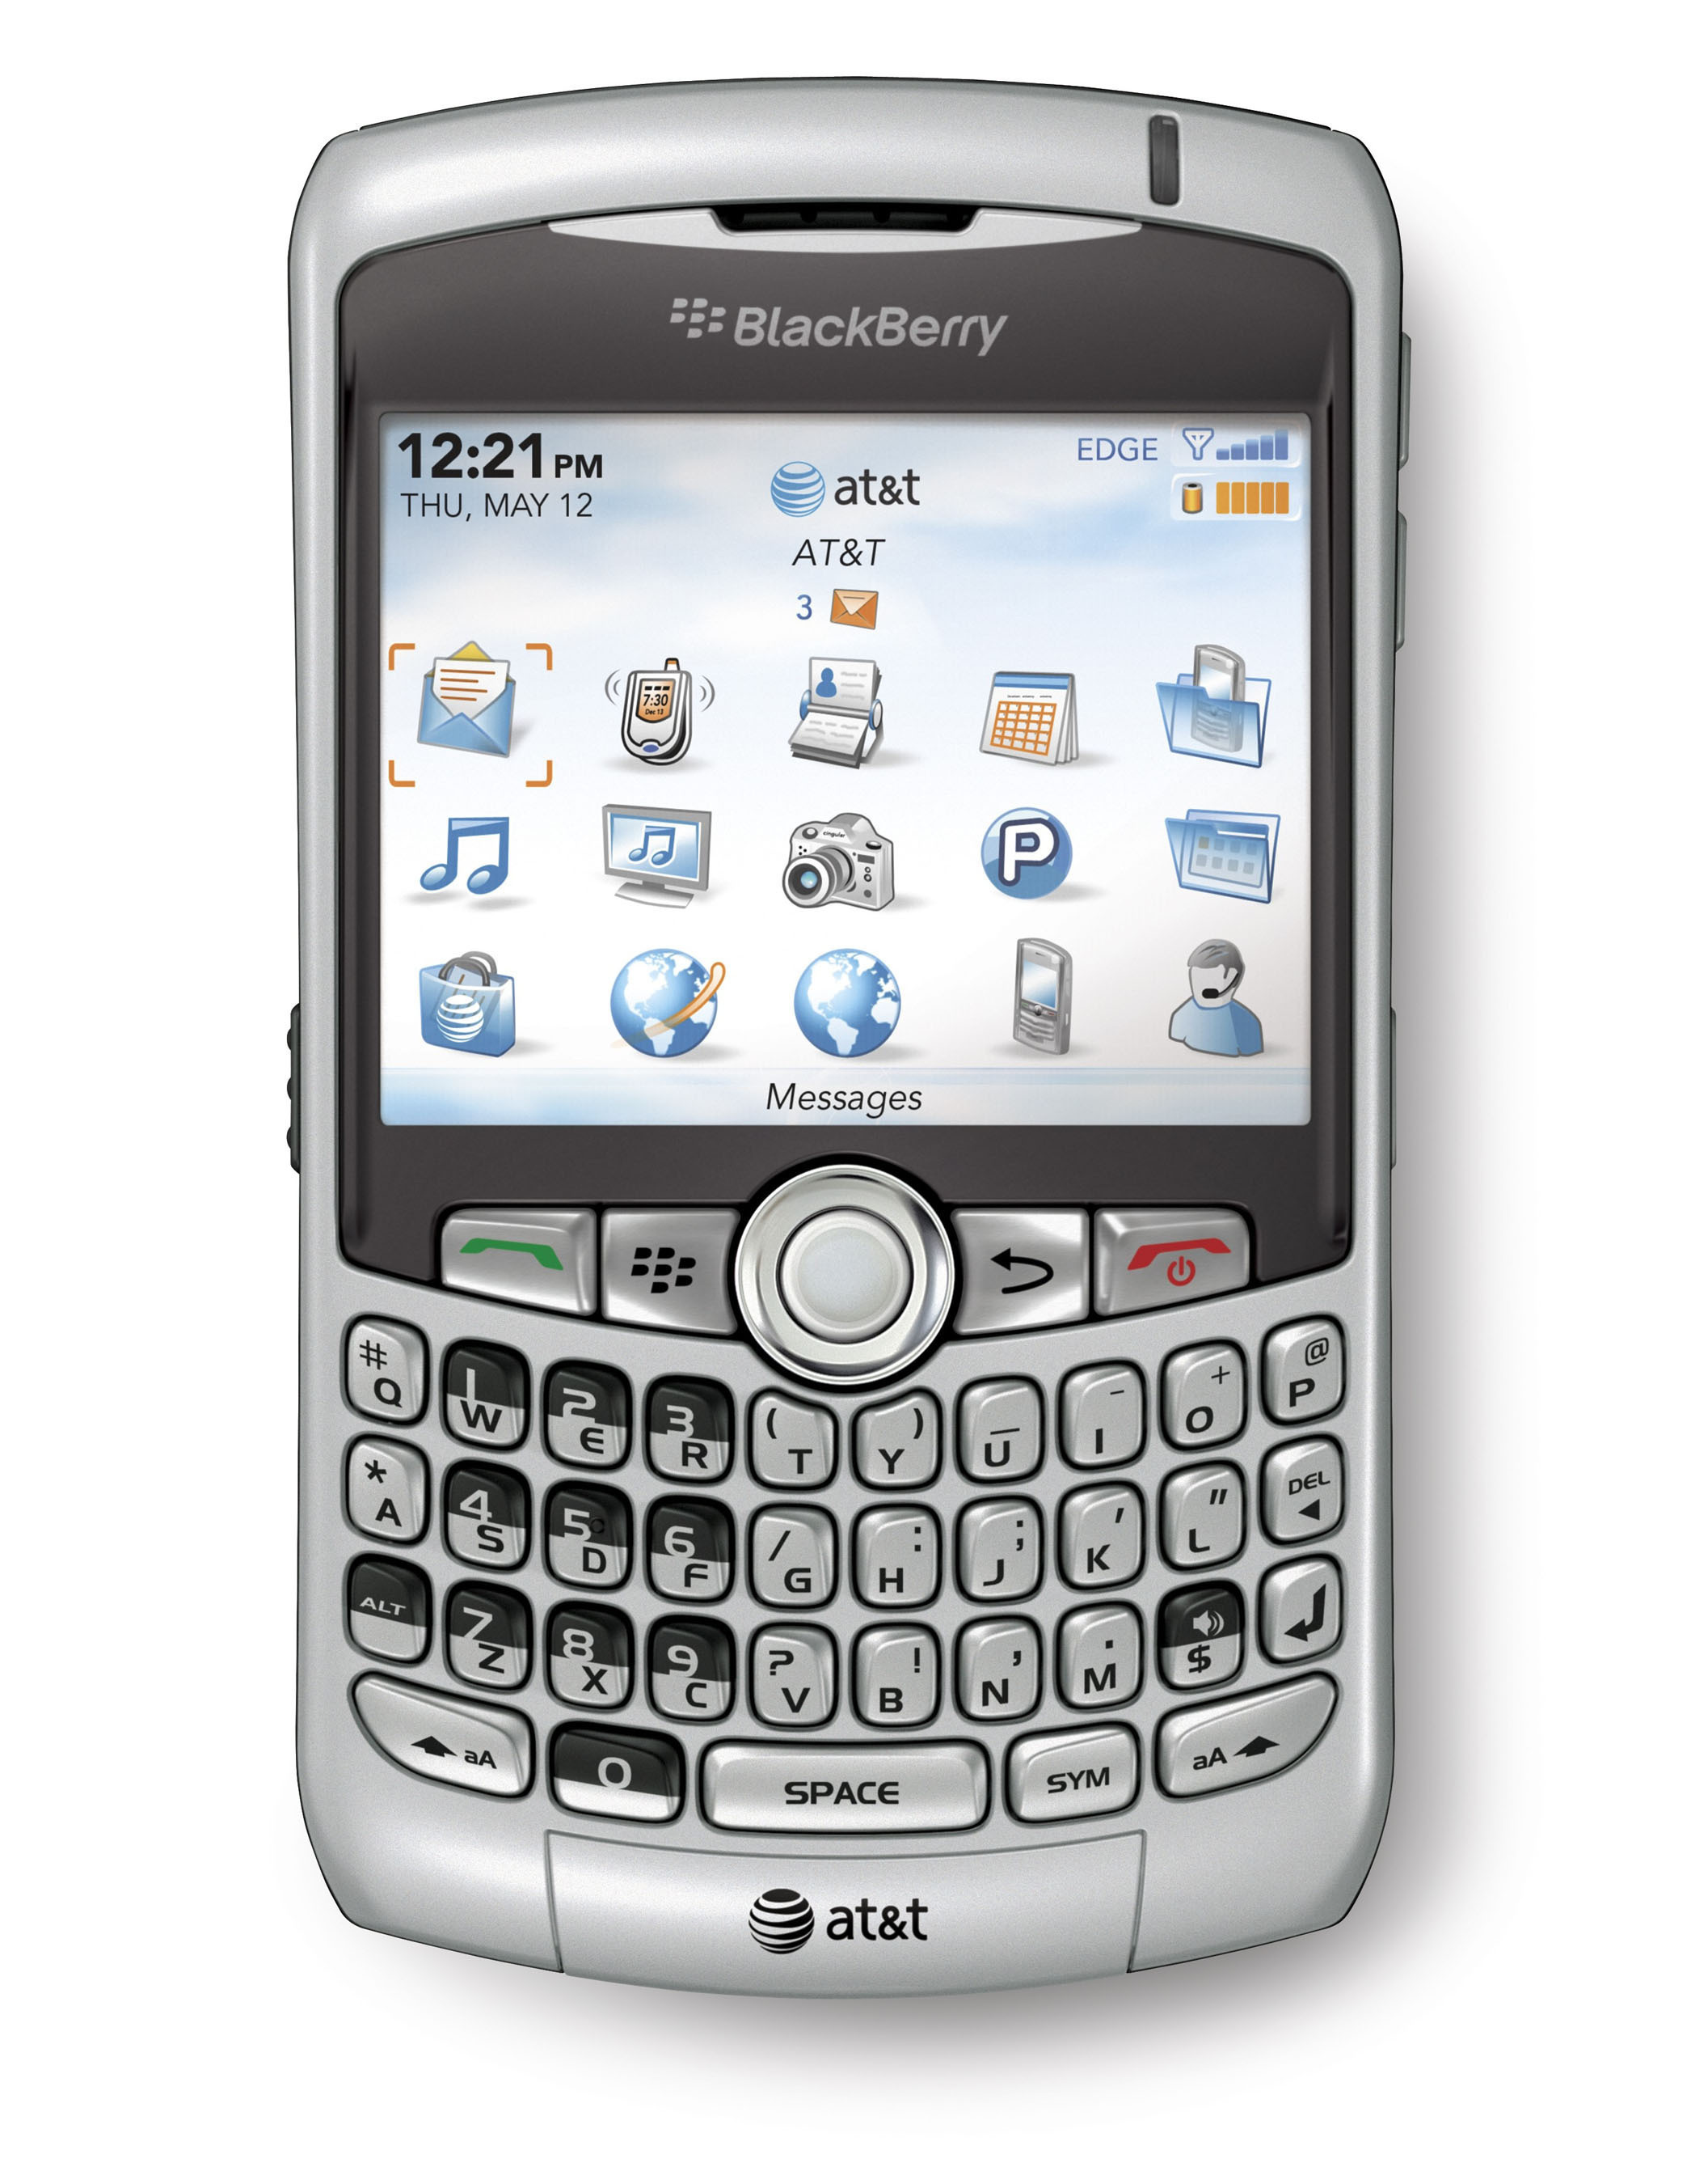
Back to GUIs

Slide 20
Review
Widgets: frame, panel, button, text field
ActionListener and MouseListener
action Performed()
mouseEntered(), mouseExited(), mouseClicked(), mousePressed(), mouseReleased
getSource()
Interface

Slide 21
Problem 1
Write a program to generate the GUI shown next. It has a menu bar with two menus labeled College and Major and one text box. College has three menu items: Purdue, IU, and Notre Dame. Major has two menu items: CS and History. The text box must display the item and the major selected.

Slide 22
Problem 1: GUI: Menu Items: College

Slide 23
Problem 1: GUI: Menu Items: Major

Slide 24
Live demo: Example 1

Slide 25
Problem 2
Modify the previous program so that the GUI now responds to menu selection events. The detected event is displayed in a message text field. The selected college is displayed in the College choice text field and the selected major in the Major choice text field.
If Purdue is selected then add
Computer Engineering to Majors.
Delete this major if IU or
Notre Dame are selected.

Slide 26
MenuListener
The following methods must be implemented:
menuSelected(MenuEvent m)
menuDeselected(MenuEvent m)
menuCanceled(MenuEvent m)

Slide 27
Live demo: Example 2

Slide 28
Problem 3
Write a program that creates three text boxes. Box 1 has the initial focus. When a string is typed in box 1 and enter pressed, the typed string is echoed in box 3 and the focus moves to box 2 When a string is typed in box 3, it is echoed in box 3 an the focus switches to box 1.

Slide 29
KeyListener
The following methods must be implemented:
keyTyped(KeyEvent m)
keyPressed(KeyEvent m)
keyReleased(KeyEvent m)
If k is a KeyEvent object then
k.getChar() returns the character typed.
k.VK_ENTER is the code for the enter key.

Slide 30
Live demo: Example 3

Slide 31
Quiz: 10/26/2011

Slide 32
Q1. ActionListener is
An object
A variable
An interface
A method

Slide 33
Q2. When using an interface we must implement
all methods in the interface
Only the methods needed by the class
Only the actionPerformed() method
Any one method in the interface

Slide 34
Q3. MouseListener is
An object
A variable
An interface
A method

Slide 35
Q4. A method used to find the object that generated an ActionEvent is
actionPerformed()
addActionListener()
getSource()
addMouseListener()

Slide 36
Q5. JTextField message=new JTextField(“10”); creates a text field named message
with 10 columns
with the default number of columns and displays an empty string
with 10 columns and displays 10
with 10 columns and displays a string consisting of 10 spaces

Slide 37
Q6. When using an abstract class we must implement
All methods in the abstract class
Only the methods needed by the class
Only the actionPerformed() method
Any one method in the abstract class

Slide 38
End of Quiz: 10/26/2011

Slide 39
Problem 4 [Try on your own]
Write a math game program to generate a GUI shown below. The GUI has two buttons labeled Div by 3 and Not Div By 3 and two text boxes. A random integer is displayed in one textbox and the player must decide whether or not it is divisible by 3. Score is displayed in the other text box.
The game never ends unless
the program is forcefully terminated.

Slide 40
Live demo: Example 4

Slide 41
Problem 4 based exercise
Modify the Divide by 3 game so that it displays the total
duration of the game in minutes and seconds in a separate text box.

Slide 42
Week 10: October 24-28, 2011
Hope you enjoyed this week!
Questions?
Contact your recitation instructor. Make full use of our office hours.

